Slide 1
REAL LIFE PUBLIC RELATION CAMPAIGN
A public relation campaign emerges when there is an urgent response need may be to fight against some disease or other bothering situation like environmental management and poverty levels. My study aims at outlining an activity that people may get engaged in to relief stress.

Slide 2
Stress can affect anybody, and therefore there is a need to work in all ways so as to minimize or manage.
Engagement in certain activities may help one in minizing stress.
Some of the most preferred activities for stress and fatigue management may include; playing games, watching other people play and judging people when playing as well as awarding them.
This games can help one make money and help to improve lifestyles since they make one tease, get engaged and involved in better activities that may not lead to stress.

Slide 3
The games have missions based on different sets to build up fortifications around the identified regions. After each game there are payers at the end of the mission given a storm forecast to help understand the right paths to end to.
In most cases human survivors who need help are considered to be optional objectives that are discovered through exploration are saiod to be contained on maps.

Slide 4
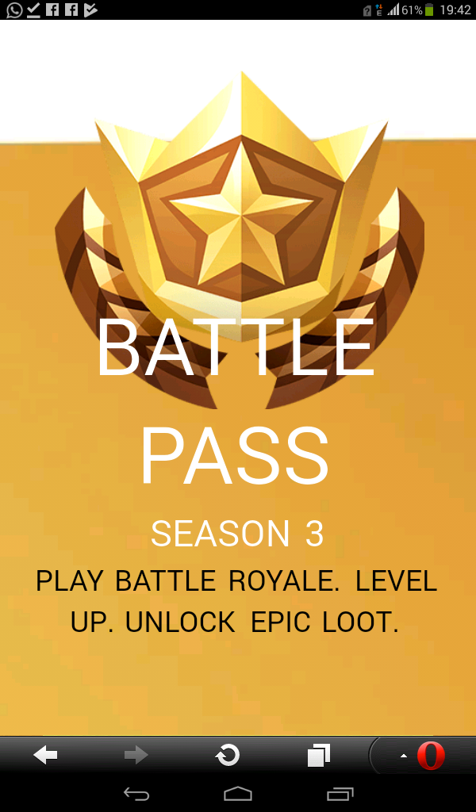
CONCLUSION

Slide 5
In conclusion, games are helpful in ones life and therefore I do comment people to opt for games so as to enable them relief stress.

